Slide 1
Minimum Spanning Tree

Slide 2
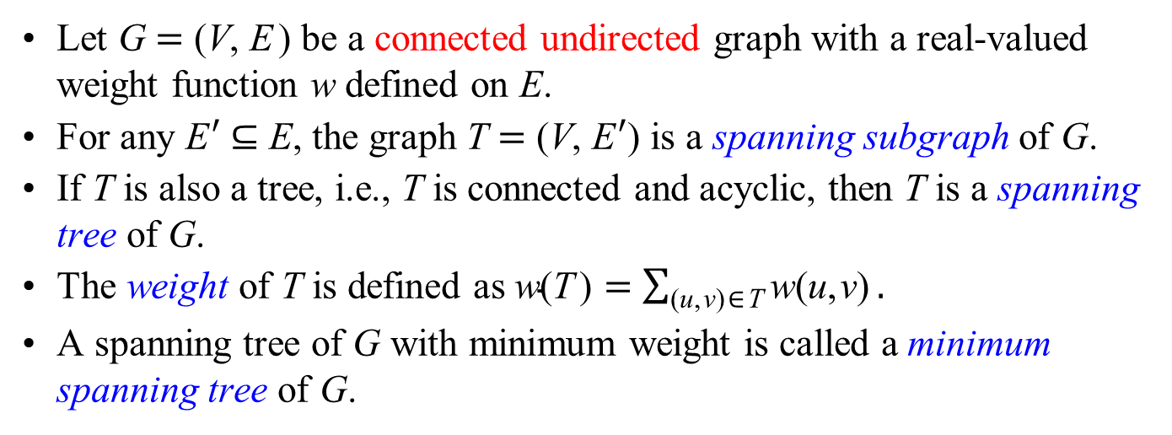
Let G = (V, E) be a connected undirected graph with a real-valued weight function w defined on E.
For any E′ ⊆ E, the graph T = (V, E′) is a spanning subgraph of G.
If T is also a tree, i.e., T is connected and acyclic, then T is a spanning tree of G.
The weight of T is defined as $\text{w}\text{(}\text{T}\text{)}=\sum_{\text{(}\text{u}\text{,}\text{v}\text{)}\text{∈}\text{T}}{\text{w}\text{(}\text{u}\text{,}\text{v}\text{)}}.$
A spanning tree of G with minimum weight is called a minimum spanning tree of G.
8
7
b
c
d
4
9
2
a
11
i
4
14
e
7
6
8
10
h
g
f
1
2

Slide 3
Prim's MST Algorithm

Slide 4
struct Neighbor
{
int id;
double weight;
};
vector< Neighbor > *adjList;
double *d;
int numNodes;
int extractMin( vector< int > &Q )
{
vector< int >::iterator min;
vector< int >::iterator it;
for( min = it = Q.begin(); it < Q.end(); ++it )
if( d[ *it ] < d[ *min ] )
min = it;
int minId = *min;
Q.erase( min );
return minId;
}

Slide 5
void Prim()
{
const int inf = 2147483647;
d = new double[ numNodes ];
int *parent = new int[ numNodes ];
bool *inQ = new bool[ numNodes ];
for( int u = 0; u < numNodes; u++ )
{
d[ u ] = inf;
parent[ u ] = -1;
inQ[ u ] = true;
}

Slide 6
d[ 0 ] = 0;
vector< int > Q;
for( int u = 0; u < numNodes; u++ )
Q.push_back( u );
while( !Q.empty() )
{
int u = extractMin( Q );
inQ[ u ] = false;
for( Neighbor v : adjList[ u ] )
if( d[ v.id ] > v.weight && inQ[ v.id ] )
{
d[ v.id ] = v.weight;
parent[ v.id ] = u;
}
}
delete[] d;
delete[] parent;
}

Slide 7
d[ 0 ] = 0;
while( !Q.empty() )
{
int u = extractMin( Q );
inQ[ u ] = false;
for( Neighbor v : adjList[ u ] )
if( d[ v.id ] > v.weight && inQ[ v.id ] )
{
d[ v.id ] = v.weight;
parent[ v.id ] = u;
}
}
delete[] d;
delete[] parent;
}
void Prim()
{
const int inf = 2147483647;
d = new double[ numNodes ];
int *parent = new int[ numNodes ];
bool *inQ = new bool[ numNodes ];
for( int u = 0; u < numNodes; u++ )
{
d[ u ] = inf;
parent[ u ] = -1;
inQ[ u ] = true;
}
vector< int > Q;
for( int u = 0; u < numNodes; u++ )
Q.push_back( u );

Slide 8
d[ 0 ] = 0;
while( !Q.empty() )
{
int u = extractMin( Q );
inQ[ u ] = false;
for( Neighbor v : adjList[ u ] )
if( d[ v.id ] > d[ u ] + v.weight && inQ[ v.id ] )
{
d[ v.id ] = d[ u ] + v.weight;
parent[ v.id ] = u;
}
}
delete[] d;
delete[] parent;
}
void Dijkstra()
{
const int inf = 2147483647;
d = new double[ numNodes ];
int *parent = new int[ numNodes ];
bool *inQ = new bool[ numNodes ];
for( int u = 0; u < numNodes; u++ )
{
d[ u ] = inf;
parent[ u ] = -1;
inQ[ u ] = true;
}
vector< int > Q;
for( int u = 0; u < numNodes; u++ )
Q.push_back( u );

Slide 9
1
4
6
8
7
∞
∞
∞
4
9
3
2
0
∞
11
∞
4
14
∞
8
7
6
8
10
∞
∞
∞
1
2
2
5
7
d[ 0 ] = 0;
vector< int > Q;
for( int u = 0; u < numNodes; u++ )
Q.push_back( u );
while( !Q.empty() )
{
int u = extractMin( Q );
inQ[ u ] = false;
for( Neighbor v : adjList[ u ] )
if( d[ v.id ] > v.weight && inQ[ v.id ] )
{
d[ v.id ] = v.weight;
parent[ v.id ] = u;
}
}

Slide 10
1
4
6
8
7
∞
∞
∞
4
9
3
2
0
0
11
∞
4
14
∞
8
7
6
8
10
∞
∞
∞
1
2
2
5
7
d[ 0 ] = 0;
vector< int > Q;
for( int u = 0; u < numNodes; u++ )
Q.push_back( u );
while( !Q.empty() )
{
int u = extractMin( Q );
inQ[ u ] = false;
for( Neighbor v : adjList[ u ] )
if( d[ v.id ] > v.weight && inQ[ v.id ] )
{
d[ v.id ] = v.weight;
parent[ v.id ] = u;
}
}

Slide 11
1
4
6
8
7
4
∞
∞
4
9
3
2
0
0
11
∞
4
14
∞
8
7
6
8
10
8
∞
∞
1
2
2
5
7
d[ 0 ] = 0;
vector< int > Q;
for( int u = 0; u < numNodes; u++ )
Q.push_back( u );
while( !Q.empty() )
{
int u = extractMin( Q );
inQ[ u ] = false;
for( Neighbor v : adjList[ u ] )
if( d[ v.id ] > v.weight && inQ[ v.id ] )
{
d[ v.id ] = v.weight;
parent[ v.id ] = u;
}
}

Slide 12
1
4
6
8
7
4
∞
∞
4
9
3
2
0
0
11
∞
4
14
∞
8
7
6
8
10
8
∞
∞
1
2
2
5
7
d[ 0 ] = 0;
vector< int > Q;
for( int u = 0; u < numNodes; u++ )
Q.push_back( u );
while( !Q.empty() )
{
int u = extractMin( Q );
inQ[ u ] = false;
for( Neighbor v : adjList[ u ] )
if( d[ v.id ] > v.weight && inQ[ v.id ] )
{
d[ v.id ] = v.weight;
parent[ v.id ] = u;
}
}

Slide 13
1
4
6
8
7
4
8
∞
4
9
3
2
0
0
11
∞
4
14
∞
8
7
6
8
10
8
∞
∞
1
2
2
5
7
d[ 0 ] = 0;
vector< int > Q;
for( int u = 0; u < numNodes; u++ )
Q.push_back( u );
while( !Q.empty() )
{
int u = extractMin( Q );
inQ[ u ] = false;
for( Neighbor v : adjList[ u ] )
if( d[ v.id ] > v.weight && inQ[ v.id ] )
{
d[ v.id ] = v.weight;
parent[ v.id ] = u;
}
}

Slide 14
1
4
6
8
7
4
8
∞
4
9
3
2
0
0
11
∞
4
14
∞
8
7
6
8
10
8
∞
∞
1
2
2
5
7
d[ 0 ] = 0;
vector< int > Q;
for( int u = 0; u < numNodes; u++ )
Q.push_back( u );
while( !Q.empty() )
{
int u = extractMin( Q );
inQ[ u ] = false;
for( Neighbor v : adjList[ u ] )
if( d[ v.id ] > v.weight && inQ[ v.id ] )
{
d[ v.id ] = v.weight;
parent[ v.id ] = u;
}
}

Slide 15
1
4
6
8
7
4
8
7
4
9
3
2
0
0
11
2
4
14
∞
8
7
6
8
10
8
∞
4
1
2
2
5
7
d[ 0 ] = 0;
vector< int > Q;
for( int u = 0; u < numNodes; u++ )
Q.push_back( u );
while( !Q.empty() )
{
int u = extractMin( Q );
inQ[ u ] = false;
for( Neighbor v : adjList[ u ] )
if( d[ v.id ] > v.weight && inQ[ v.id ] )
{
d[ v.id ] = v.weight;
parent[ v.id ] = u;
}
}

Slide 16
1
4
6
8
7
4
8
7
4
9
3
2
0
0
11
2
4
14
∞
8
7
6
8
10
8
∞
4
1
2
2
5
7
d[ 0 ] = 0;
vector< int > Q;
for( int u = 0; u < numNodes; u++ )
Q.push_back( u );
while( !Q.empty() )
{
int u = extractMin( Q );
inQ[ u ] = false;
for( Neighbor v : adjList[ u ] )
if( d[ v.id ] > v.weight && inQ[ v.id ] )
{
d[ v.id ] = v.weight;
parent[ v.id ] = u;
}
}

Slide 17
1
4
6
8
7
4
8
7
4
9
3
2
0
0
11
2
4
14
∞
8
7
6
8
10
7
6
4
1
2
2
5
7
d[ 0 ] = 0;
vector< int > Q;
for( int u = 0; u < numNodes; u++ )
Q.push_back( u );
while( !Q.empty() )
{
int u = extractMin( Q );
inQ[ u ] = false;
for( Neighbor v : adjList[ u ] )
if( d[ v.id ] > v.weight && inQ[ v.id ] )
{
d[ v.id ] = v.weight;
parent[ v.id ] = u;
}
}

Slide 18
1
4
6
8
7
4
8
7
4
9
3
2
0
0
11
2
4
14
∞
8
7
6
8
10
7
6
4
1
2
2
5
7
d[ 0 ] = 0;
vector< int > Q;
for( int u = 0; u < numNodes; u++ )
Q.push_back( u );
while( !Q.empty() )
{
int u = extractMin( Q );
inQ[ u ] = false;
for( Neighbor v : adjList[ u ] )
if( d[ v.id ] > v.weight && inQ[ v.id ] )
{
d[ v.id ] = v.weight;
parent[ v.id ] = u;
}
}

Slide 19
1
4
6
8
7
4
8
7
4
9
3
2
0
0
11
2
4
14
10
8
7
6
8
10
7
2
4
1
2
2
5
7
d[ 0 ] = 0;
vector< int > Q;
for( int u = 0; u < numNodes; u++ )
Q.push_back( u );
while( !Q.empty() )
{
int u = extractMin( Q );
inQ[ u ] = false;
for( Neighbor v : adjList[ u ] )
if( d[ v.id ] > v.weight && inQ[ v.id ] )
{
d[ v.id ] = v.weight;
parent[ v.id ] = u;
}
}

Slide 20
1
4
6
8
7
4
8
7
4
9
3
2
0
0
11
2
4
14
10
8
7
6
8
10
7
2
4
1
2
2
5
7
d[ 0 ] = 0;
vector< int > Q;
for( int u = 0; u < numNodes; u++ )
Q.push_back( u );
while( !Q.empty() )
{
int u = extractMin( Q );
inQ[ u ] = false;
for( Neighbor v : adjList[ u ] )
if( d[ v.id ] > v.weight && inQ[ v.id ] )
{
d[ v.id ] = v.weight;
parent[ v.id ] = u;
}
}

Slide 21
1
4
6
8
7
4
8
7
4
9
3
2
0
0
11
2
4
14
10
8
7
6
8
10
1
2
4
1
2
2
5
7
d[ 0 ] = 0;
vector< int > Q;
for( int u = 0; u < numNodes; u++ )
Q.push_back( u );
while( !Q.empty() )
{
int u = extractMin( Q );
inQ[ u ] = false;
for( Neighbor v : adjList[ u ] )
if( d[ v.id ] > v.weight && inQ[ v.id ] )
{
d[ v.id ] = v.weight;
parent[ v.id ] = u;
}
}

Slide 22
1
4
6
8
7
4
8
7
4
9
3
2
0
0
11
2
4
14
10
8
7
6
8
10
1
2
4
1
2
2
5
7
d[ 0 ] = 0;
vector< int > Q;
for( int u = 0; u < numNodes; u++ )
Q.push_back( u );
while( !Q.empty() )
{
int u = extractMin( Q );
inQ[ u ] = false;
for( Neighbor v : adjList[ u ] )
if( d[ v.id ] > v.weight && inQ[ v.id ] )
{
d[ v.id ] = v.weight;
parent[ v.id ] = u;
}
}

Slide 23
1
4
6
8
7
4
8
7
4
9
3
2
0
0
11
2
4
14
10
8
7
6
8
10
1
2
4
1
2
2
5
7
d[ 0 ] = 0;
vector< int > Q;
for( int u = 0; u < numNodes; u++ )
Q.push_back( u );
while( !Q.empty() )
{
int u = extractMin( Q );
inQ[ u ] = false;
for( Neighbor v : adjList[ u ] )
if( d[ v.id ] > v.weight && inQ[ v.id ] )
{
d[ v.id ] = v.weight;
parent[ v.id ] = u;
}
}

Slide 24
1
4
6
8
7
4
8
7
4
9
3
2
0
0
11
2
4
14
9
8
7
6
8
10
1
2
4
1
2
2
5
7
d[ 0 ] = 0;
vector< int > Q;
for( int u = 0; u < numNodes; u++ )
Q.push_back( u );
while( !Q.empty() )
{
int u = extractMin( Q );
inQ[ u ] = false;
for( Neighbor v : adjList[ u ] )
if( d[ v.id ] > v.weight && inQ[ v.id ] )
{
d[ v.id ] = v.weight;
parent[ v.id ] = u;
}
}

Slide 25
1
4
6
8
7
4
8
7
4
9
3
2
0
0
11
2
4
14
9
8
7
6
8
10
1
2
4
1
2
2
5
7
d[ 0 ] = 0;
vector< int > Q;
for( int u = 0; u < numNodes; u++ )
Q.push_back( u );
while( !Q.empty() )
{
int u = extractMin( Q );
inQ[ u ] = false;
for( Neighbor v : adjList[ u ] )
if( d[ v.id ] > v.weight && inQ[ v.id ] )
{
d[ v.id ] = v.weight;
parent[ v.id ] = u;
}
}

Slide 26
d[ 0 ] = 0;
while( !Q.empty() )
{
int u = extractMin( Q );
inQ[ u ] = false;
for( Neighbor v : adjList[ u ] )
if( d[ v.id ] > v.weight && inQ[ v.id ] )
{
d[ v.id ] = v.weight;
parent[ v.id ] = u;
}
}
delete[] d;
delete[] parent;
}
void Prim()
{
const int inf = 2147483647;
d = new double[ numNodes ];
int *parent = new int[ numNodes ];
bool *inQ = new bool[ numNodes ];
for( int u = 0; u < numNodes; u++ )
{
d[ u ] = inf;
parent[ u ] = -1;
inQ[ u ] = true;
}
vector< int > Q;
for( int u = 0; u < numNodes; u++ )
Q.push_back( u );

Slide 27
1
4
6
8
7
4
∞
∞
4
9
3
2
0
0
11
∞
4
14
∞
8
7
6
8
10
8
∞
∞
1
2
2
5
7
d[ 0 ] = 0;
vector< int > Q;
for( int u = 0; u < numNodes; u++ )
Q.push_back( u );
while( !Q.empty() )
{
int u = extractMin( Q );
inQ[ u ] = false;
for( Neighbor v : adjList[ u ] )
if( d[ v.id ] > v.weight && inQ[ v.id ] )
{
d[ v.id ] = v.weight;
parent[ v.id ] = u;
}
}

Slide 28
1
4
6
8
7
4
8
∞
4
9
3
2
0
0
11
∞
4
14
∞
8
7
6
8
10
8
∞
∞
1
2
2
5
7
d[ 0 ] = 0;
vector< int > Q;
for( int u = 0; u < numNodes; u++ )
Q.push_back( u );
while( !Q.empty() )
{
int u = extractMin( Q );
inQ[ u ] = false;
for( Neighbor v : adjList[ u ] )
if( d[ v.id ] > v.weight && inQ[ v.id ] )
{
d[ v.id ] = v.weight;
parent[ v.id ] = u;
}
}

Slide 29
1
4
6
8
7
4
8
7
4
9
3
2
0
0
11
2
4
14
∞
8
7
6
8
10
8
∞
4
1
2
2
5
7
d[ 0 ] = 0;
vector< int > Q;
for( int u = 0; u < numNodes; u++ )
Q.push_back( u );
while( !Q.empty() )
{
int u = extractMin( Q );
inQ[ u ] = false;
for( Neighbor v : adjList[ u ] )
if( d[ v.id ] > v.weight && inQ[ v.id ] )
{
d[ v.id ] = v.weight;
parent[ v.id ] = u;
}
}

Slide 30
1
4
6
8
7
4
8
7
4
9
3
2
0
0
11
2
4
14
∞
8
7
6
8
10
7
6
4
1
2
2
5
7
d[ 0 ] = 0;
vector< int > Q;
for( int u = 0; u < numNodes; u++ )
Q.push_back( u );
while( !Q.empty() )
{
int u = extractMin( Q );
inQ[ u ] = false;
for( Neighbor v : adjList[ u ] )
if( d[ v.id ] > v.weight && inQ[ v.id ] )
{
d[ v.id ] = v.weight;
parent[ v.id ] = u;
}
}

Slide 31
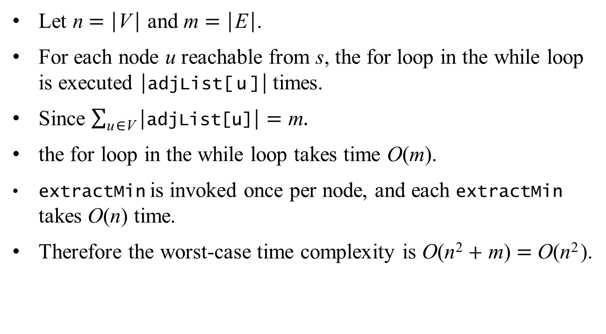
The Worst-case Time Complexity
Let n = |V| and m = |E|.
For each node u reachable from s, the for loop in the while loop is executed |adjList[u]| times.
Since $\sum_{\text{u}\text{∈}\text{V}}{\text{|}\text{adjList}\text{[}\text{u}\text{]}\text{|}}=\text{m}.$
the for loop in the while loop takes time O(m).
extractMin is invoked once per node, and each extractMin takes O(n) time.
Therefore the worst-case time complexity is O(n² + m) = O(n²).

Slide 32
void Prim()
{
const int inf = 2147483647;
heap.resize( numNodes );
double *d = new double[ numNodes ];
int *parent = new int[ numNodes ];
bool *inHeap = new bool[ numNodes ];
index = new int[ numNodes ];
for( int u = 0; u < numNodes; u++ )
{
heap[ u ].id = u;
heap[ u ].d = inf;
d[ u ] = inf;
parent[ u ] = -1;
inHeap[ u ] = true;
index[ u ] = u;
}

Slide 33
heap[ 0 ].d = 0;
d[ 0 ] = 0;
while( !heap.empty() )
{
int u = extractMin();
inHeap[ u ] = false;
for( Neighbor v : adjList[ u ] )
if( d[ v.id ] > v.weight && inHeap[ v.id ] )
{
d[ v.id ] = v.weight;
parent[ v.id ] = u;
heapDecreaseKey( index[ v.id ], d[ v.id ] );
}
}
delete[] d;
delete[] parent;
delete[] index;
}

Slide 34
int extractMin()
{
if( heap.size() < 1 )
cout << "heap underflow\n";
int min = heap[ 0 ].id;
heap[ 0 ] = heap[ heap.size() - 1 ];
index[ heap[ heap.size() - 1 ].id ] = 0;
heap.pop_back();
minHeapify( 0 );
return min;
}
void swap( int i, int j )
{
HeapNode buffer = heap[ i ];
heap[ i ] = heap[ j ];
heap[ j ] = buffer;
}

Slide 35
void minHeapify( int i )
{
int smallest;
size_t l = 2 * i + 1;
size_t r = 2 * i + 2;
if( l < heap.size() && heap[ l ].d < heap[ i ].d )
smallest = l;
else
smallest = i;
if( r < heap.size() && heap[ r ].d < heap[ smallest ].d )
smallest = r;
if( smallest != i )
{
index[ heap[ i ].id ] = smallest;
index[ heap[ smallest ].id ] = i;
swap( i, smallest );
minHeapify( smallest );
}
}

Slide 36
void heapDecreaseKey( int i, double d )
{
if( d > heap[ i ].d )
cout << "new key is larger than current key\n";
else
{
int parent = ( i - 1 ) / 2;
heap[ i ].d = d;
while( i > 0 && heap[ parent ].d > heap[ i ].d )
{
index[ heap[ i ].id ] = parent;
index[ heap[ parent ].id ] = i;
swap( i, parent );
i = parent;
parent = ( i - 1 ) / 2;
}
}
}

Slide 37
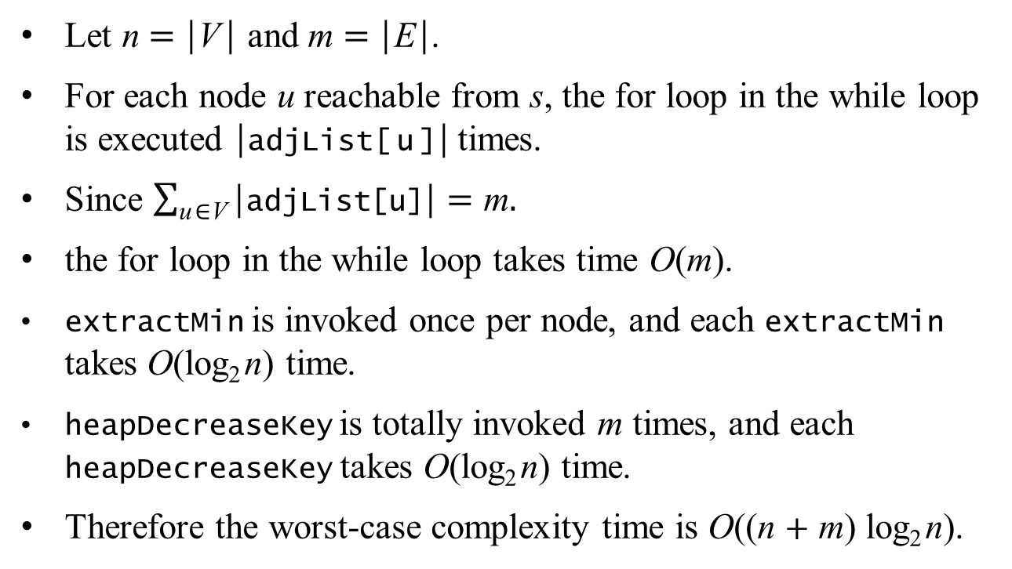
The Worst-case Time Complexity
Let n = |V| and m = |E|.
For each node u reachable from s, the for loop in the while loop is executed |adjList[u]| times.
Since $\sum_{\text{u}\text{∈}\text{V}}{\text{|}\text{adjList}\text{[}\text{u}\text{]}\text{|}}=\text{m}.$
the for loop in the while loop takes time O(m).
extractMin is invoked once per node, and each extractMin takes O(log₂n) time.
heapDecreaseKey is totally invoked m times, and each heapDecreaseKey takes O(log₂n) time.
Therefore the worst-case complexity time is O((n + m) log₂n).

Slide 38
Kruskal's MST Algorithm

Slide 39
Kruskal's MST Algorithm
8
7
1
4
6
4
9
2
0
11
3
4
14
8
7
6
8
10
2
5
7
1
2

Slide 40
Kruskal's MST Algorithm
8
7
1
4
6
4
9
2
0
11
3
4
14
8
7
6
8
10
2
5
7
1
2

Slide 41
Kruskal's MST Algorithm
8
7
1
4
6
4
9
2
0
11
3
4
14
8
7
6
8
10
2
5
7
1
2

Slide 42
Kruskal's MST Algorithm
8
7
1
4
6
4
9
2
0
11
3
4
14
8
7
6
8
10
2
5
7
1
2

Slide 43
Kruskal's MST Algorithm
8
7
1
4
6
4
9
2
0
11
3
4
14
8
7
6
8
10
2
5
7
1
2

Slide 44
Kruskal's MST Algorithm
8
7
1
4
6
4
9
2
0
11
3
4
14
8
7
6
8
10
2
5
7
1
2

Slide 45
Kruskal's MST Algorithm
8
7
1
4
6
4
9
2
0
11
3
4
14
8
7
6
8
10
2
5
7
1
2

Slide 46
Kruskal's MST Algorithm
8
7
1
4
6
4
9
2
0
11
3
4
14
8
7
6
8
10
2
5
7
1
2

Slide 47
Kruskal's MST Algorithm
8
7
1
4
6
4
9
2
0
11
3
4
14
8
7
6
8
10
2
5
7
1
2

Slide 48
Kruskal's MST Algorithm
8
7
1
4
6
4
9
2
0
11
3
4
14
8
7
6
8
10
2
5
7
1
2

Slide 49
Kruskal's MST Algorithm
8
7
1
4
6
4
9
2
0
11
3
4
14
8
7
6
8
10
2
5
7
1
2

Slide 50
Kruskal's MST Algorithm
8
7
1
4
6
4
9
2
0
11
3
4
14
8
7
6
8
10
2
5
7
1
2

Slide 51
Kruskal's MST Algorithm
8
7
1
4
6
4
9
2
0
11
3
4
14
8
7
6
8
10
2
5
7
1
2

Slide 52
Kruskal's MST Algorithm
8
7
1
4
6
4
9
2
0
11
3
4
14
8
7
6
8
10
2
5
7
1
2

Slide 53
Kruskal's MST Algorithm
8
7
1
4
6
4
9
2
0
11
3
4
14
8
7
6
8
10
2
5
7
1
2

Slide 54
Kruskal's MST Algorithm
8
7
1
4
6
4
9
2
0
11
3
4
14
8
7
6
8
10
2
5
7
1
2

Slide 55
Kruskal's MST Algorithm
void kruskalMST()
{
for( Edge &e : edgeList )
e.isTreeEdge = false;
set = new int[ numNodes ];
for( int i = 0; i < numNodes; i++ )
set[ i ] = i;
for( Edge &e : edgeList )
{
int x = set[ e.endPoint1 ];
int y = set[ e.endPoint2 ];
if( x != y )
{
e.isTreeEdge = true;
link( x, y );
}
}
delete[] set;
}
struct Edge
{
int endPoint1;
int endPoint2;
double weight;
bool isTreeEdge;
};
vector< Edge > edgeList;

Slide 56
Kruskal's MST Algorithm
void link( int x, int y )
{
if( x < y )
{
for( int i = 0; i < numNodes; i++ )
if( set[ i ] == y )
set[ i ] = x;
}
else
{
for( int i = 0; i < numNodes; i++ )
if( set[ i ] == x )
set[ i ] = y;
}
}

Slide 57
8
7
1
4
6
4
9
2
0
11
3
4
14
8
7
6
8
10
2
5
7
1
2
 | 0 | 1 | 2 | 3 | 4 | 5 | 6 | 7 | 8
set | 0 | 1 | 2 | 3 | 4 | 5 | 6 | 7 | 8
for( Edge &e : edgeList )
{
int x = set[ e.endPoint1 ];
int y = set[ e.endPoint2 ];
if( x != y )
{
e.isTreeEdge = true;
link( x, y );
}
}

Slide 58
8
7
1
4
6
4
9
2
0
11
3
4
14
8
7
6
8
10
2
5
7
1
2
 | 0 | 1 | 2 | 3 | 4 | 5 | 6 | 7 | 8
set | 0 | 1 | 2 | 3 | 4 | 5 | 6 | 7 | 8
void link( int x, int y )
{
if( x < y )
{
for( int i = 0; i < numNodes; i++ )
if( set[ i ] == y )
set[ i ] = x;
}
else
{
for( int i = 0; i < numNodes; i++ )
if( set[ i ] == x )
set[ i ] = y;
}
}

Slide 59
8
7
1
4
6
4
9
2
0
11
3
4
14
8
7
6
8
10
2
5
7
1
2
 | 0 | 1 | 2 | 3 | 4 | 5 | 6 | 7 | 8
set | 0 | 1 | 2 | 3 | 4 | 2 | 6 | 7 | 8
void link( int x, int y )
{
if( x < y )
{
for( int i = 0; i < numNodes; i++ )
if( set[ i ] == y )
set[ i ] = x;
}
else
{
for( int i = 0; i < numNodes; i++ )
if( set[ i ] == x )
set[ i ] = y;
}
}

Slide 60
8
7
1
4
6
4
9
2
0
11
3
4
14
8
7
6
8
10
2
5
7
1
2
 | 0 | 1 | 2 | 3 | 4 | 5 | 6 | 7 | 8
set | 0 | 1 | 2 | 3 | 4 | 2 | 6 | 7 | 8
for( Edge &e : edgeList )
{
int x = set[ e.endPoint1 ];
int y = set[ e.endPoint2 ];
if( x != y )
{
e.isTreeEdge = true;
link( x, y );
}
}

Slide 61
8
7
1
4
6
4
9
2
0
11
3
4
14
8
7
6
8
10
2
5
7
1
2
 | 0 | 1 | 2 | 3 | 4 | 5 | 6 | 7 | 8
set | 0 | 1 | 2 | 3 | 4 | 2 | 6 | 7 | 8
void link( int x, int y )
{
if( x < y )
{
for( int i = 0; i < numNodes; i++ )
if( set[ i ] == y )
set[ i ] = x;
}
else
{
for( int i = 0; i < numNodes; i++ )
if( set[ i ] == x )
set[ i ] = y;
}
}

Slide 62
8
7
1
4
6
4
9
2
0
11
3
4
14
8
7
6
8
10
2
5
7
1
2
 | 0 | 1 | 2 | 3 | 4 | 5 | 6 | 7 | 8
set | 0 | 1 | 2 | 3 | 3 | 2 | 6 | 7 | 8
void link( int x, int y )
{
if( x < y )
{
for( int i = 0; i < numNodes; i++ )
if( set[ i ] == y )
set[ i ] = x;
}
else
{
for( int i = 0; i < numNodes; i++ )
if( set[ i ] == x )
set[ i ] = y;
}
}

Slide 63
8
7
1
4
6
4
9
2
0
11
3
4
14
8
7
6
8
10
2
5
7
1
2
 | 0 | 1 | 2 | 3 | 4 | 5 | 6 | 7 | 8
set | 0 | 1 | 2 | 3 | 3 | 2 | 6 | 7 | 8
for( Edge &e : edgeList )
{
int x = set[ e.endPoint1 ];
int y = set[ e.endPoint2 ];
if( x != y )
{
e.isTreeEdge = true;
link( x, y );
}
}

Slide 64
8
7
1
4
6
4
9
2
0
11
3
4
14
8
7
6
8
10
2
5
7
1
2
 | 0 | 1 | 2 | 3 | 4 | 5 | 6 | 7 | 8
set | 0 | 1 | 2 | 3 | 3 | 2 | 6 | 7 | 8
void link( int x, int y )
{
if( x < y )
{
for( int i = 0; i < numNodes; i++ )
if( set[ i ] == y )
set[ i ] = x;
}
else
{
for( int i = 0; i < numNodes; i++ )
if( set[ i ] == x )
set[ i ] = y;
}
}

Slide 65
8
7
1
4
6
4
9
2
0
11
3
4
14
8
7
6
8
10
2
5
7
1
2
 | 0 | 1 | 2 | 3 | 4 | 5 | 6 | 7 | 8
set | 0 | 1 | 2 | 3 | 3 | 2 | 6 | 2 | 8
void link( int x, int y )
{
if( x < y )
{
for( int i = 0; i < numNodes; i++ )
if( set[ i ] == y )
set[ i ] = x;
}
else
{
for( int i = 0; i < numNodes; i++ )
if( set[ i ] == x )
set[ i ] = y;
}
}

Slide 66
8
7
1
4
6
4
9
2
0
11
3
4
14
8
7
6
8
10
2
5
7
1
2
 | 0 | 1 | 2 | 3 | 4 | 5 | 6 | 7 | 8
set | 0 | 1 | 2 | 3 | 3 | 2 | 6 | 2 | 8
for( Edge &e : edgeList )
{
int x = set[ e.endPoint1 ];
int y = set[ e.endPoint2 ];
if( x != y )
{
e.isTreeEdge = true;
link( x, y );
}
}

Slide 67
8
7
1
4
6
4
9
2
0
11
3
4
14
8
7
6
8
10
2
5
7
1
2
 | 0 | 1 | 2 | 3 | 4 | 5 | 6 | 7 | 8
set | 0 | 0 | 2 | 3 | 3 | 2 | 6 | 2 | 8
void link( int x, int y )
{
if( x < y )
{
for( int i = 0; i < numNodes; i++ )
if( set[ i ] == y )
set[ i ] = x;
}
else
{
for( int i = 0; i < numNodes; i++ )
if( set[ i ] == x )
set[ i ] = y;
}
}

Slide 68
8
7
1
4
6
4
9
2
0
11
3
4
14
8
7
6
8
10
2
5
7
1
2
 | 0 | 1 | 2 | 3 | 4 | 5 | 6 | 7 | 8
set | 0 | 0 | 2 | 3 | 3 | 2 | 6 | 2 | 8
for( Edge &e : edgeList )
{
int x = set[ e.endPoint1 ];
int y = set[ e.endPoint2 ];
if( x != y )
{
e.isTreeEdge = true;
link( x, y );
}
}

Slide 69
8
7
1
4
6
4
9
2
0
11
3
4
14
8
7
6
8
10
2
5
7
1
2
 | 0 | 1 | 2 | 3 | 4 | 5 | 6 | 7 | 8
set | 0 | 0 | 2 | 3 | 3 | 2 | 6 | 2 | 8
void link( int x, int y )
{
if( x < y )
{
for( int i = 0; i < numNodes; i++ )
if( set[ i ] == y )
set[ i ] = x;
}
else
{
for( int i = 0; i < numNodes; i++ )
if( set[ i ] == x )
set[ i ] = y;
}
}

Slide 70
8
7
1
4
6
4
9
2
0
11
3
4
14
8
7
6
8
10
2
5
7
1
2
 | 0 | 1 | 2 | 3 | 4 | 5 | 6 | 7 | 8
set | 0 | 0 | 2 | 2 | 2 | 2 | 6 | 2 | 8
void link( int x, int y )
{
if( x < y )
{
for( int i = 0; i < numNodes; i++ )
if( set[ i ] == y )
set[ i ] = x;
}
else
{
for( int i = 0; i < numNodes; i++ )
if( set[ i ] == x )
set[ i ] = y;
}
}

Slide 71
8
7
1
4
6
4
9
2
0
11
3
4
14
8
7
6
8
10
2
5
7
1
2
 | 0 | 1 | 2 | 3 | 4 | 5 | 6 | 7 | 8
set | 0 | 0 | 2 | 2 | 2 | 2 | 6 | 2 | 8
for( Edge &e : edgeList )
{
int x = set[ e.endPoint1 ];
int y = set[ e.endPoint2 ];
if( x != y )
{
e.isTreeEdge = true;
link( x, y );
}
}

Slide 72
8
7
1
4
6
4
9
2
0
11
3
4
14
8
7
6
8
10
2
5
7
1
2
 | 0 | 1 | 2 | 3 | 4 | 5 | 6 | 7 | 8
set | 0 | 0 | 2 | 2 | 2 | 2 | 6 | 2 | 8
for( Edge &e : edgeList )
{
int x = set[ e.endPoint1 ];
int y = set[ e.endPoint2 ];
if( x != y )
{
e.isTreeEdge = true;
link( x, y );
}
}

Slide 73
8
7
1
4
6
4
9
2
0
11
3
4
14
8
7
6
8
10
2
5
7
1
2
 | 0 | 1 | 2 | 3 | 4 | 5 | 6 | 7 | 8
set | 0 | 0 | 2 | 2 | 2 | 2 | 6 | 2 | 8
void link( int x, int y )
{
if( x < y )
{
for( int i = 0; i < numNodes; i++ )
if( set[ i ] == y )
set[ i ] = x;
}
else
{
for( int i = 0; i < numNodes; i++ )
if( set[ i ] == x )
set[ i ] = y;
}
}

Slide 74
8
7
1
4
6
4
9
2
0
11
3
4
14
8
7
6
8
10
2
5
7
1
2
 | 0 | 1 | 2 | 3 | 4 | 5 | 6 | 7 | 8
set | 0 | 0 | 2 | 2 | 2 | 2 | 2 | 2 | 8
void link( int x, int y )
{
if( x < y )
{
for( int i = 0; i < numNodes; i++ )
if( set[ i ] == y )
set[ i ] = x;
}
else
{
for( int i = 0; i < numNodes; i++ )
if( set[ i ] == x )
set[ i ] = y;
}
}

Slide 75
8
7
1
4
6
4
9
2
0
11
3
4
14
8
7
6
8
10
2
5
7
1
2
 | 0 | 1 | 2 | 3 | 4 | 5 | 6 | 7 | 8
set | 0 | 0 | 2 | 2 | 2 | 2 | 2 | 2 | 8
for( Edge &e : edgeList )
{
int x = set[ e.endPoint1 ];
int y = set[ e.endPoint2 ];
if( x != y )
{
e.isTreeEdge = true;
link( x, y );
}
}

Slide 76
8
7
1
4
6
4
9
2
0
11
3
4
14
8
7
6
8
10
2
5
7
1
2
 | 0 | 1 | 2 | 3 | 4 | 5 | 6 | 7 | 8
set | 0 | 0 | 2 | 2 | 2 | 2 | 2 | 2 | 8
for( Edge &e : edgeList )
{
int x = set[ e.endPoint1 ];
int y = set[ e.endPoint2 ];
if( x != y )
{
e.isTreeEdge = true;
link( x, y );
}
}

Slide 77
8
7
1
4
6
4
9
2
0
11
3
4
14
8
7
6
8
10
2
5
7
1
2
 | 0 | 1 | 2 | 3 | 4 | 5 | 6 | 7 | 8
set | 0 | 0 | 2 | 2 | 2 | 2 | 2 | 2 | 8
void link( int x, int y )
{
if( x < y )
{
for( int i = 0; i < numNodes; i++ )
if( set[ i ] == y )
set[ i ] = x;
}
else
{
for( int i = 0; i < numNodes; i++ )
if( set[ i ] == x )
set[ i ] = y;
}
}

Slide 78
8
7
1
4
6
4
9
2
0
11
3
4
14
8
7
6
8
10
2
5
7
1
2
 | 0 | 1 | 2 | 3 | 4 | 5 | 6 | 7 | 8
set | 0 | 0 | 0 | 0 | 0 | 0 | 0 | 0 | 8
void link( int x, int y )
{
if( x < y )
{
for( int i = 0; i < numNodes; i++ )
if( set[ i ] == y )
set[ i ] = x;
}
else
{
for( int i = 0; i < numNodes; i++ )
if( set[ i ] == x )
set[ i ] = y;
}
}

Slide 79
8
7
1
4
6
4
9
2
0
11
3
4
14
8
7
6
8
10
2
5
7
1
2
 | 0 | 1 | 2 | 3 | 4 | 5 | 6 | 7 | 8
set | 0 | 0 | 0 | 0 | 0 | 0 | 0 | 0 | 8
for( Edge &e : edgeList )
{
int x = set[ e.endPoint1 ];
int y = set[ e.endPoint2 ];
if( x != y )
{
e.isTreeEdge = true;
link( x, y );
}
}

Slide 80
8
7
1
4
6
4
9
2
0
11
3
4
14
8
7
6
8
10
2
5
7
1
2
 | 0 | 1 | 2 | 3 | 4 | 5 | 6 | 7 | 8
set | 0 | 0 | 0 | 0 | 0 | 0 | 0 | 0 | 8
for( Edge &e : edgeList )
{
int x = set[ e.endPoint1 ];
int y = set[ e.endPoint2 ];
if( x != y )
{
e.isTreeEdge = true;
link( x, y );
}
}

Slide 81
8
7
1
4
6
4
9
2
0
11
3
4
14
8
7
6
8
10
2
5
7
1
2
 | 0 | 1 | 2 | 3 | 4 | 5 | 6 | 7 | 8
set | 0 | 0 | 0 | 0 | 0 | 0 | 0 | 0 | 8
void link( int x, int y )
{
if( x < y )
{
for( int i = 0; i < numNodes; i++ )
if( set[ i ] == y )
set[ i ] = x;
}
else
{
for( int i = 0; i < numNodes; i++ )
if( set[ i ] == x )
set[ i ] = y;
}
}

Slide 82
8
7
1
4
6
4
9
2
0
11
3
4
14
8
7
6
8
10
2
5
7
1
2
 | 0 | 1 | 2 | 3 | 4 | 5 | 6 | 7 | 8
set | 0 | 0 | 0 | 0 | 0 | 0 | 0 | 0 | 0
void link( int x, int y )
{
if( x < y )
{
for( int i = 0; i < numNodes; i++ )
if( set[ i ] == y )
set[ i ] = x;
}
else
{
for( int i = 0; i < numNodes; i++ )
if( set[ i ] == x )
set[ i ] = y;
}
}

Slide 83
8
7
1
4
6
4
9
2
0
11
3
4
14
8
7
6
8
10
2
5
7
1
2
 | 0 | 1 | 2 | 3 | 4 | 5 | 6 | 7 | 8
set | 0 | 0 | 0 | 0 | 0 | 0 | 0 | 0 | 0
for( Edge &e : edgeList )
{
int x = set[ e.endPoint1 ];
int y = set[ e.endPoint2 ];
if( x != y )
{
e.isTreeEdge = true;
link( x, y );
}
}

Slide 84
8
7
1
4
6
4
9
2
0
11
3
4
14
8
7
6
8
10
2
5
7
1
2
 | 0 | 1 | 2 | 3 | 4 | 5 | 6 | 7 | 8
set | 0 | 0 | 0 | 0 | 0 | 0 | 0 | 0 | 0
for( Edge &e : edgeList )
{
int x = set[ e.endPoint1 ];
int y = set[ e.endPoint2 ];
if( x != y )
{
e.isTreeEdge = true;
link( x, y );
}
}

Slide 85
8
7
1
4
6
4
9
2
0
11
3
4
14
8
7
6
8
10
2
5
7
1
2
 | 0 | 1 | 2 | 3 | 4 | 5 | 6 | 7 | 8
set | 0 | 0 | 0 | 0 | 0 | 0 | 0 | 0 | 0
for( Edge &e : edgeList )
{
int x = set[ e.endPoint1 ];
int y = set[ e.endPoint2 ];
if( x != y )
{
e.isTreeEdge = true;
link( x, y );
}
}

Slide 86
8
7
1
4
6
4
9
2
0
11
3
4
14
8
7
6
8
10
2
5
7
1
2
 | 0 | 1 | 2 | 3 | 4 | 5 | 6 | 7 | 8
set | 0 | 0 | 0 | 0 | 0 | 0 | 0 | 0 | 0
for( Edge &e : edgeList )
{
int x = set[ e.endPoint1 ];
int y = set[ e.endPoint2 ];
if( x != y )
{
e.isTreeEdge = true;
link( x, y );
}
}

Slide 87
void kruskalMST()
{
for( Edge &e : edgeList )
e.isTreeEdge = false;
parent = new int[ numNodes ];
rank = new int[ numNodes ];
for( int i = 0; i < numNodes; i++ )
{
parent[ i ] = i;
rank[ i ] = 0;
}
for( Edge &e : edgeList )
{
int x = findSet( e.endPoint1 );
int y = findSet( e.endPoint2 );
if( x != y )
{
e.isTreeEdge = true;
link( x, y );
}
}
delete[] parent;
delete[] rank;
}
struct Edge
{
int endPoint1;
int endPoint2;
double weight;
bool isTreeEdge;
};
struct Node
{
long parent;
long rank;
};
Node *forest;

Slide 88
int findSet( int x )
{
if( x != parent[ x ] )
parent[ x ] = findSet( parent[ x ] );
return parent[ x ];
}
void link( int x, int y )
{
if( rank[ x ] > rank[ y ] )
parent[ y ] = x;
else
{
parent[ x ] = y;
if( rank[ x ] == rank[ y ] )
rank[ y ] = rank[ y ] + 1;
}
}

Slide 89
Disjoint-set Forests

Slide 90
int findSet( int x )
{
if( x != parent[ x ] )
parent[ x ] = findSet( parent[ x ] );
return parent[ x ];
}
findSet( 3 )
0
findSet( 2 )
1
findSet( 1 )
2
findSet( 0 )
3

Slide 91
int findSet( int x )
{
if( x != parent[ x ] )
parent[ x ] = findSet( parent[ x ] );
return parent[ x ];
}
findSet( 3 )
0
findSet( 2 )
1
findSet( 1 )
2
0
findSet( 0 )
3

Slide 92
int findSet( int x )
{
if( x != parent[ x ] )
parent[ x ] = findSet( parent[ x ] );
return parent[ x ];
}
findSet( 3 )
0
findSet( 2 )
0
1
findSet( 1 )
2
0
findSet( 0 )
3

Slide 93
int findSet( int x )
{
if( x != parent[ x ] )
parent[ x ] = findSet( parent[ x ] );
return parent[ x ];
}
findSet( 3 )
0
findSet( 2 )
0
1
2
findSet( 1 )
3
0
findSet( 0 )

Slide 94
int findSet( int x )
{
if( x != parent[ x ] )
parent[ x ] = findSet( parent[ x ] );
return parent[ x ];
}
findSet( 3 )
0
0
findSet( 2 )
0
1
2
findSet( 1 )
3
0
findSet( 0 )

Slide 95
int findSet( int x )
{
if( x != parent[ x ] )
parent[ x ] = findSet( parent[ x ] );
return parent[ x ];
}
findSet( 3 )
0
0
findSet( 2 )
0
1
2
3
findSet( 1 )
0
findSet( 0 )

Slide 96
void kruskalMST()
{
for( Edge &e : edgeList )
e.isTreeEdge = false;
parent = new int[ numNodes ];
rank = new int[ numNodes ];
for( int i = 0; i < numNodes; i++ )
{
parent[ i ] = i;
rank[ i ] = 0;
}
for( Edge &e : edgeList )
{
int x = findSet( e.endPoint1 );
int y = findSet( e.endPoint2 );
if( x != y )
{
e.isTreeEdge = true;
link( x, y );
}
}
delete[] parent;
delete[] rank;
}
struct Edge
{
int endPoint1;
int endPoint2;
double weight;
bool isTreeEdge;
};
struct Node
{
long parent;
long rank;
};
Node *forest;

Slide 97
int findSet( int x )
{
if( x != parent[ x ] )
parent[ x ] = findSet( parent[ x ] );
return parent[ x ];
}
void link( int x, int y )
{
if( rank[ x ] > rank[ y ] )
parent[ y ] = x;
else
{
parent[ x ] = y;
if( rank[ x ] == rank[ y ] )
rank[ y ] = rank[ y ] + 1;
}
}

Slide 98
8
7
int findSet( int x )
{
if( x != p[x] )
p[x] = fS( p[x] );
return p[x];
}
1
4
6
4
9
2
0
11
3
4
14
8
7
6
8
10
2
5
7
1
2
findSet( 2 ) = 2
findSet( 5 ) = 5
for( Edge &e : edgeList )
{
int x = findSet( e.endPoint1 );
int y = findSet( e.endPoint2 );
if( x != y )
{
e.isTreeEdge = true;
link( x, y );
}
}

Slide 99
8
7
int findSet( int x )
{
if( x != p[x] )
p[x] = fS( p[x] );
return p[x];
}
1
4
6
4
9
2
0
11
3
4
14
8
7
6
8
10
2
5
7
1
2
findSet( 2 ) = 2
findSet( 5 ) = 5
void link( int x, int y )
{
if( rank[ x ] > rank[ y ] )
parent[ y ] = x;
else
{
parent[ x ] = y;
if( rank[ x ] == rank[ y ] )
rank[ y ] = rank[ y ] + 1;
}
}

Slide 100
8
7
int findSet( int x )
{
if( x != p[x] )
p[x] = fS( p[x] );
return p[x];
}
1
4
6
4
9
2
0
11
3
4
14
8
7
6
8
10
2
5
7
1
2
findSet( 2 ) = 2
findSet( 5 ) = 5
void link( int x, int y )
{
if( rank[ x ] > rank[ y ] )
parent[ y ] = x;
else
{
parent[ x ] = y;
if( rank[ x ] == rank[ y ] )
rank[ y ] = rank[ y ] + 1;
}
}
rank = 1
5
2

Slide 101
8
7
int findSet( int x )
{
if( x != p[x] )
p[x] = fS( p[x] );
return p[x];
}
1
4
6
4
9
2
0
11
3
4
14
8
7
6
8
10
2
5
7
1
2
findSet( 3 ) = 3
findSet( 4 ) = 4
for( Edge &e : edgeList )
{
int x = findSet( e.endPoint1 );
int y = findSet( e.endPoint2 );
if( x != y )
{
e.isTreeEdge = true;
link( x, y );
}
}
rank = 1
5
2

Slide 102
8
7
int findSet( int x )
{
if( x != p[x] )
p[x] = fS( p[x] );
return p[x];
}
1
4
6
4
9
2
0
11
3
4
14
8
7
6
8
10
2
5
7
1
2
findSet( 3 ) = 3
findSet( 4 ) = 4
for( Edge &e : edgeList )
{
int x = findSet( e.endPoint1 );
int y = findSet( e.endPoint2 );
if( x != y )
{
e.isTreeEdge = true;
link( x, y );
}
}
rank = 1
5
2

Slide 103
8
7
int findSet( int x )
{
if( x != p[x] )
p[x] = fS( p[x] );
return p[x];
}
1
4
6
4
9
2
0
11
3
4
14
8
7
6
8
10
2
5
7
1
2
findSet( 3 ) = 3
findSet( 4 ) = 4
void link( int x, int y )
{
if( rank[ x ] > rank[ y ] )
parent[ y ] = x;
else
{
parent[ x ] = y;
if( rank[ x ] == rank[ y ] )
rank[ y ] = rank[ y ] + 1;
}
}
rank = 1
5
2

Slide 104
8
7
int findSet( int x )
{
if( x != p[x] )
p[x] = fS( p[x] );
return p[x];
}
1
4
6
4
9
2
0
11
3
4
14
8
7
6
8
10
2
5
7
1
2
findSet( 3 ) = 3
findSet( 4 ) = 4
void link( int x, int y )
{
if( rank[ x ] > rank[ y ] )
parent[ y ] = x;
else
{
parent[ x ] = y;
if( rank[ x ] == rank[ y ] )
rank[ y ] = rank[ y ] + 1;
}
}
rank = 1
rank = 1
5
4
2
3

Slide 105
8
7
int findSet( int x )
{
if( x != p[x] )
p[x] = fS( p[x] );
return p[x];
}
1
4
6
4
9
2
0
11
3
4
14
8
7
6
8
10
2
5
7
1
2
findSet( 5 ) = 5
findSet( 7 ) = 7
for( Edge &e : edgeList )
{
int x = findSet( e.endPoint1 );
int y = findSet( e.endPoint2 );
if( x != y )
{
e.isTreeEdge = true;
link( x, y );
}
}
rank = 1
rank = 1
5
4
2
3

Slide 106
8
7
int findSet( int x )
{
if( x != p[x] )
p[x] = fS( p[x] );
return p[x];
}
1
4
6
4
9
2
0
11
3
4
14
8
7
6
8
10
2
5
7
1
2
findSet( 5 ) = 5
findSet( 7 ) = 7
for( Edge &e : edgeList )
{
int x = findSet( e.endPoint1 );
int y = findSet( e.endPoint2 );
if( x != y )
{
e.isTreeEdge = true;
link( x, y );
}
}
rank = 1
rank = 1
5
4
2
3

Slide 107
8
7
int findSet( int x )
{
if( x != p[x] )
p[x] = fS( p[x] );
return p[x];
}
1
4
6
4
9
2
0
11
3
4
14
8
7
6
8
10
2
5
7
1
2
findSet( 5 ) = 5
findSet( 7 ) = 7
void link( int x, int y )
{
if( rank[ x ] > rank[ y ] )
parent[ y ] = x;
else
{
parent[ x ] = y;
if( rank[ x ] == rank[ y ] )
rank[ y ] = rank[ y ] + 1;
}
}
rank = 1
rank = 1
5
4
2
3

Slide 108
8
7
int findSet( int x )
{
if( x != p[x] )
p[x] = fS( p[x] );
return p[x];
}
1
4
6
4
9
2
0
11
3
4
14
8
7
6
8
10
2
5
7
1
2
findSet( 5 ) = 5
findSet( 7 ) = 7
void link( int x, int y )
{
if( rank[ x ] > rank[ y ] )
parent[ y ] = x;
else
{
parent[ x ] = y;
if( rank[ x ] == rank[ y ] )
rank[ y ] = rank[ y ] + 1;
}
}
rank = 1
rank = 1
5
4
2
7
3

Slide 109
8
7
int findSet( int x )
{
if( x != p[x] )
p[x] = fS( p[x] );
return p[x];
}
1
4
6
4
9
2
0
11
3
4
14
8
7
6
8
10
2
5
7
1
2
findSet( 0 ) = 0
findSet( 1 ) = 1
for( Edge &e : edgeList )
{
int x = findSet( e.endPoint1 );
int y = findSet( e.endPoint2 );
if( x != y )
{
e.isTreeEdge = true;
link( x, y );
}
}
rank = 1
rank = 1
5
4
2
7
3

Slide 110
8
7
int findSet( int x )
{
if( x != p[x] )
p[x] = fS( p[x] );
return p[x];
}
1
4
6
4
9
2
0
11
3
4
14
8
7
6
8
10
2
5
7
1
2
findSet( 0 ) = 0
findSet( 1 ) = 1
void link( int x, int y )
{
if( rank[ x ] > rank[ y ] )
parent[ y ] = x;
else
{
parent[ x ] = y;
if( rank[ x ] == rank[ y ] )
rank[ y ] = rank[ y ] + 1;
}
}
rank = 1
rank = 1
5
4
2
7
3

Slide 111
8
7
int findSet( int x )
{
if( x != p[x] )
p[x] = fS( p[x] );
return p[x];
}
1
4
6
4
9
2
0
11
3
4
14
8
7
6
8
10
2
5
7
1
2
findSet( 0 ) = 0
findSet( 1 ) = 1
void link( int x, int y )
{
if( rank[ x ] > rank[ y ] )
parent[ y ] = x;
else
{
parent[ x ] = y;
if( rank[ x ] == rank[ y ] )
rank[ y ] = rank[ y ] + 1;
}
}
rank = 1
rank = 1
rank = 1
1
5
4
0
2
7
3

Slide 112
8
7
int findSet( int x )
{
if( x != p[x] )
p[x] = fS( p[x] );
return p[x];
}
1
4
6
4
9
2
0
11
3
4
14
8
7
6
8
10
2
5
7
1
2
findSet( 4 ) = 4
findSet( 7 ) = 5
for( Edge &e : edgeList )
{
int x = findSet( e.endPoint1 );
int y = findSet( e.endPoint2 );
if( x != y )
{
e.isTreeEdge = true;
link( x, y );
}
}
rank = 1
rank = 1
rank = 1
1
5
4
0
2
7
3

Slide 113
8
7
int findSet( int x )
{
if( x != p[x] )
p[x] = fS( p[x] );
return p[x];
}
1
4
6
4
9
2
0
11
3
4
14
8
7
6
8
10
2
5
7
1
2
findSet( 4 ) = 4
findSet( 7 ) = 5
void link( int x, int y )
{
if( rank[ x ] > rank[ y ] )
parent[ y ] = x;
else
{
parent[ x ] = y;
if( rank[ x ] == rank[ y ] )
rank[ y ] = rank[ y ] + 1;
}
}
rank = 1
rank = 1
rank = 1
1
5
4
0
2
7
3

Slide 114
8
7
int findSet( int x )
{
if( x != p[x] )
p[x] = fS( p[x] );
return p[x];
}
1
4
6
4
9
2
0
11
3
4
14
8
7
6
8
10
2
5
7
1
2
findSet( 4 ) = 4
findSet( 7 ) = 5
void link( int x, int y )
{
if( rank[ x ] > rank[ y ] )
parent[ y ] = x;
else
{
parent[ x ] = y;
if( rank[ x ] == rank[ y ] )
rank[ y ] = rank[ y ] + 1;
}
}
rank = 2
5
rank = 1
1
2
7
4
0
3

Slide 115
8
7
int findSet( int x )
{
if( x != p[x] )
p[x] = fS( p[x] );
return p[x];
}
1
4
6
4
9
2
0
11
3
4
14
8
7
6
8
10
2
5
7
1
2
findSet( 3 ) = 5
findSet( 5 ) = 5
for( Edge &e : edgeList )
{
int x = findSet( e.endPoint1 );
int y = findSet( e.endPoint2 );
if( x != y )
{
e.isTreeEdge = true;
link( x, y );
}
}
rank = 2
5
rank = 1
1
2
7
4
0
3

Slide 116
8
7
int findSet( int x )
{
if( x != p[x] )
p[x] = fS( p[x] );
return p[x];
}
1
4
6
4
9
2
0
11
3
4
14
8
7
6
8
10
2
5
7
1
2
findSet( 3 ) = 5
findSet( 5 ) = 5
for( Edge &e : edgeList )
{
int x = findSet( e.endPoint1 );
int y = findSet( e.endPoint2 );
if( x != y )
{
e.isTreeEdge = true;
link( x, y );
}
}
rank = 2
5
rank = 1
1
2
7
4
0
3

Slide 117
8
7
int findSet( int x )
{
if( x != p[x] )
p[x] = fS( p[x] );
return p[x];
}
1
4
6
4
9
2
0
11
3
4
14
8
7
6
8
10
2
5
7
1
2
findSet( 4 ) = 5
findSet( 6 ) = 6
for( Edge &e : edgeList )
{
int x = findSet( e.endPoint1 );
int y = findSet( e.endPoint2 );
if( x != y )
{
e.isTreeEdge = true;
link( x, y );
}
}
rank = 2
5
rank = 1
1
2
7
4
0
3

Slide 118
8
7
int findSet( int x )
{
if( x != p[x] )
p[x] = fS( p[x] );
return p[x];
}
1
4
6
4
9
2
0
11
3
4
14
8
7
6
8
10
2
5
7
1
2
findSet( 4 ) = 5
findSet( 6 ) = 6
void link( int x, int y )
{
if( rank[ x ] > rank[ y ] )
parent[ y ] = x;
else
{
parent[ x ] = y;
if( rank[ x ] == rank[ y ] )
rank[ y ] = rank[ y ] + 1;
}
}
rank = 2
5
rank = 1
1
2
7
4
0
3

Slide 119
8
7
int findSet( int x )
{
if( x != p[x] )
p[x] = fS( p[x] );
return p[x];
}
1
4
6
4
9
2
0
11
3
4
14
8
7
6
8
10
2
5
7
1
2
findSet( 4 ) = 5
findSet( 6 ) = 6
void link( int x, int y )
{
if( rank[ x ] > rank[ y ] )
parent[ y ] = x;
else
{
parent[ x ] = y;
if( rank[ x ] == rank[ y ] )
rank[ y ] = rank[ y ] + 1;
}
}
rank = 2
5
rank = 1
1
2
7
4
6
0
3

Slide 120
8
7
int findSet( int x )
{
if( x != p[x] )
p[x] = fS( p[x] );
return p[x];
}
1
4
6
4
9
2
0
11
3
4
14
8
7
6
8
10
2
5
7
1
2
findSet( 2 ) = 5
findSet( 3 ) = 5
for( Edge &e : edgeList )
{
int x = findSet( e.endPoint1 );
int y = findSet( e.endPoint2 );
if( x != y )
{
e.isTreeEdge = true;
link( x, y );
}
}
rank = 2
5
rank = 1
1
2
7
4
6
0
3

Slide 121
8
7
int findSet( int x )
{
if( x != p[x] )
p[x] = fS( p[x] );
return p[x];
}
1
4
6
4
9
2
0
11
3
4
14
8
7
6
8
10
2
5
7
1
2
findSet( 0 ) = 1
findSet( 2 ) = 5
for( Edge &e : edgeList )
{
int x = findSet( e.endPoint1 );
int y = findSet( e.endPoint2 );
if( x != y )
{
e.isTreeEdge = true;
link( x, y );
}
}
rank = 2
5
rank = 1
1
2
7
4
6
0
3

Slide 122
8
7
int findSet( int x )
{
if( x != p[x] )
p[x] = fS( p[x] );
return p[x];
}
1
4
6
4
9
2
0
11
3
4
14
8
7
6
8
10
2
5
7
1
2
findSet( 0 ) = 1
findSet( 2 ) = 5
void link( int x, int y )
{
if( rank[ x ] > rank[ y ] )
parent[ y ] = x;
else
{
parent[ x ] = y;
if( rank[ x ] == rank[ y ] )
rank[ y ] = rank[ y ] + 1;
}
}
rank = 2
5
rank = 1
1
2
7
4
6
0
3

Slide 123
8
7
int findSet( int x )
{
if( x != p[x] )
p[x] = fS( p[x] );
return p[x];
}
1
4
6
4
9
2
0
11
3
4
14
8
7
6
8
10
2
5
7
1
2
findSet( 0 ) = 1
findSet( 2 ) = 5
void link( int x, int y )
{
if( rank[ x ] > rank[ y ] )
parent[ y ] = x;
else
{
parent[ x ] = y;
if( rank[ x ] == rank[ y ] )
rank[ y ] = rank[ y ] + 1;
}
}
rank = 2
5
1
2
7
4
6
0
3

Slide 124
8
7
int findSet( int x )
{
if( x != p[x] )
p[x] = fS( p[x] );
return p[x];
}
1
4
6
4
9
2
0
11
3
4
14
8
7
6
8
10
2
5
7
1
2
findSet( 1 ) = 5
findSet( 4 ) = 5
for( Edge &e : edgeList )
{
int x = findSet( e.endPoint1 );
int y = findSet( e.endPoint2 );
if( x != y )
{
e.isTreeEdge = true;
link( x, y );
}
}
rank = 2
5
1
2
7
4
6
0
3

Slide 125
8
7
int findSet( int x )
{
if( x != p[x] )
p[x] = fS( p[x] );
return p[x];
}
1
4
6
4
9
2
0
11
3
4
14
8
7
6
8
10
2
5
7
1
2
findSet( 6 ) = 5
findSet( 8 ) = 8
for( Edge &e : edgeList )
{
int x = findSet( e.endPoint1 );
int y = findSet( e.endPoint2 );
if( x != y )
{
e.isTreeEdge = true;
link( x, y );
}
}
rank = 2
5
1
2
7
4
6
0
3

Slide 126
8
7
int findSet( int x )
{
if( x != p[x] )
p[x] = fS( p[x] );
return p[x];
}
1
4
6
4
9
2
0
11
3
4
14
8
7
6
8
10
2
5
7
1
2
findSet( 6 ) = 5
findSet( 8 ) = 8
void link( int x, int y )
{
if( rank[ x ] > rank[ y ] )
parent[ y ] = x;
else
{
parent[ x ] = y;
if( rank[ x ] == rank[ y ] )
rank[ y ] = rank[ y ] + 1;
}
}
rank = 2
5
1
2
7
4
6
0
3

Slide 127
8
7
int findSet( int x )
{
if( x != p[x] )
p[x] = fS( p[x] );
return p[x];
}
1
4
6
4
9
2
0
11
3
4
14
8
7
6
8
10
2
5
7
1
2
findSet( 6 ) = 5
findSet( 8 ) = 8
void link( int x, int y )
{
if( rank[ x ] > rank[ y ] )
parent[ y ] = x;
else
{
parent[ x ] = y;
if( rank[ x ] == rank[ y ] )
rank[ y ] = rank[ y ] + 1;
}
}
rank = 2
5
8
1
2
7
4
6
0
3

Slide 128
8
7
int findSet( int x )
{
if( x != p[x] )
p[x] = fS( p[x] );
return p[x];
}
1
4
6
4
9
2
0
11
3
4
14
8
7
6
8
10
2
5
7
1
2
findSet( 7 ) = 5
findSet( 8 ) = 5
for( Edge &e : edgeList )
{
int x = findSet( e.endPoint1 );
int y = findSet( e.endPoint2 );
if( x != y )
{
e.isTreeEdge = true;
link( x, y );
}
}
rank = 2
5
8
1
2
7
4
6
0
3

Slide 129
8
7
int findSet( int x )
{
if( x != p[x] )
p[x] = fS( p[x] );
return p[x];
}
1
4
6
4
9
2
0
11
3
4
14
8
7
6
8
10
2
5
7
1
2
findSet( 1 ) = 5
findSet( 2 ) = 5
for( Edge &e : edgeList )
{
int x = findSet( e.endPoint1 );
int y = findSet( e.endPoint2 );
if( x != y )
{
e.isTreeEdge = true;
link( x, y );
}
}
rank = 2
5
8
1
2
7
4
6
0
3

Slide 130
8
7
int findSet( int x )
{
if( x != p[x] )
p[x] = fS( p[x] );
return p[x];
}
1
4
6
4
9
2
0
11
3
4
14
8
7
6
8
10
2
5
7
1
2
findSet( 6 ) = 5
findSet( 7 ) = 5
for( Edge &e : edgeList )
{
int x = findSet( e.endPoint1 );
int y = findSet( e.endPoint2 );
if( x != y )
{
e.isTreeEdge = true;
link( x, y );
}
}
rank = 2
5
8
1
2
7
4
6
0
3

Slide 131
8
7
int findSet( int x )
{
if( x != p[x] )
p[x] = fS( p[x] );
return p[x];
}
1
4
6
4
9
2
0
11
3
4
14
8
7
6
8
10
2
5
7
1
2
findSet( 6 ) = 5
findSet( 7 ) = 5
for( Edge &e : edgeList )
{
int x = findSet( e.endPoint1 );
int y = findSet( e.endPoint2 );
if( x != y )
{
e.isTreeEdge = true;
link( x, y );
}
}
rank = 2
5
8
1
2
7
4
6
0
3

Slide 132
void kruskalMST()
{
for( Edge &e : edgeList )
e.isTreeEdge = false;
parent = new int[ numNodes ];
rank = new int[ numNodes ];
for( int i = 0; i < numNodes; i++ )
{
parent[ i ] = i;
rank[ i ] = 0;
}
for( Edge &e : edgeList )
{
int x = findSet( e.endPoint1 );
int y = findSet( e.endPoint2 );
if( x != y )
{
e.isTreeEdge = true;
link( x, y );
}
}
delete[] parent;
delete[] rank;
}
struct Edge
{
int endPoint1;
int endPoint2;
double weight;
bool isTreeEdge;
};
struct Node
{
long parent;
long rank;
};
Node *forest;

Slide 133
The Worst-case Time Complexity
The worst-case time complexity of Kruskal's algorithm is O(mlog₂n), where n = |V| and m = |E|.

Slide 134
The Worst-case Time Complexity
The worst-case time complexity of Kruskal's algorithm is O(mlog₂n), where n = |V| and m = |E|.

Slide 135
The for loop of lines 5-8 performs O(E) FIND-SET and UNION operations on the disjoint-set forest. Along with the V MAKE-SET operations, these take a total of O(V + E)α(V)) time, where α is the very slowly growing function defined in Section 21.4. Because we assume that G is connected, we have E ≥ V −1, and so the disjoint-set operations take O(Eα(V)) time. Moreover, since α(V) = O(lgV) = O(lgE), the total running time of Kruskal’s algorithm is O(ElgE). Observing that E < V², we have lgE = O(lgV), and so we can restate the running time of Kruskal’s algorithm as O(ElgV).

Slide 136
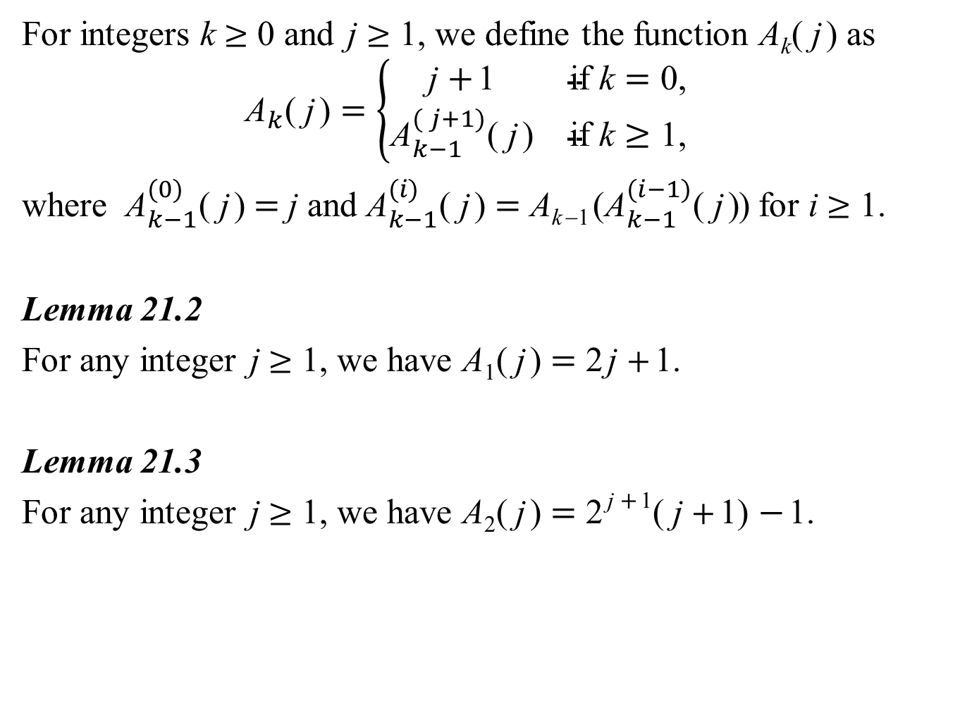
For integers k ≥ 0 and j ≥ 1, we define the function A_{k}( j) as
$${\text{A}}_{k}\text{( }\text{j}\text{)}=\left\{\begin{matrix}\text{j} \text{+}\text{1} & \text{if} \text{k}=\text{0,} \\ {\text{A}}_{k−1}^{( j+1)}\text{( }\text{j}\text{)} & \text{if} \text{k}≥\text{1,}\end{matrix}\right.$$
where ${\text{A}}_{k−1}^{(0)}\text{( }\text{j}\text{)}$ = j and ${\text{A}}_{k−1}^{(i)}\text{( }\text{j}\text{)}$ = A_{k−1}(${\text{A}}_{k−1}^{(i−1)}\text{( }\text{j}\text{)}$) for i ≥ 1.
Lemma 21.2
For any integer j ≥ 1, we have A₁( j) = 2j +1.
Lemma 21.3
For any integer j ≥ 1, we have A₂( j) = 2^{j +1}( j +1) −1.

Slide 137
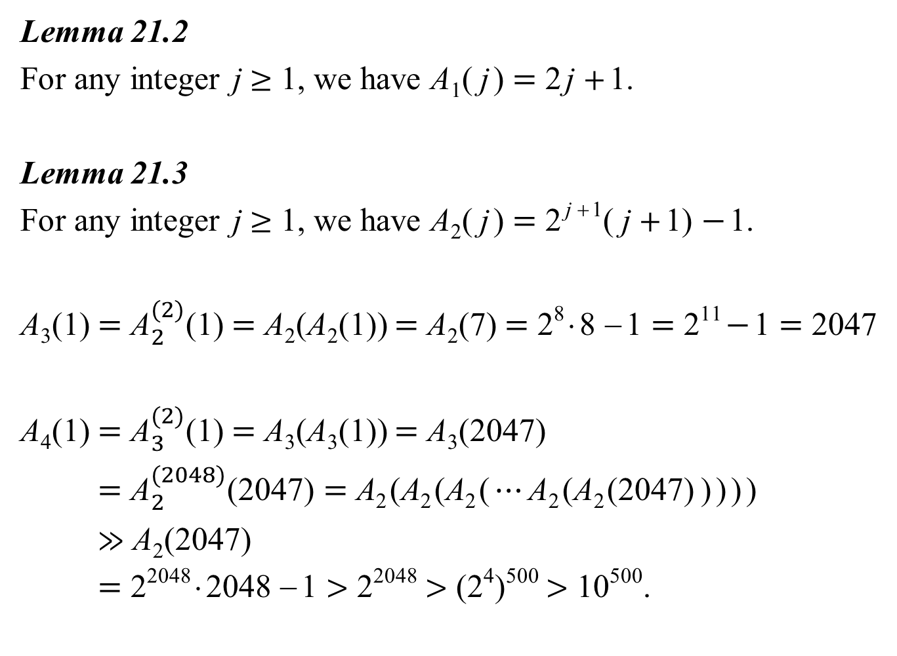
Lemma 21.2
For any integer j ≥ 1, we have A₁( j) = 2j +1.
Lemma 21.3
For any integer j ≥ 1, we have A₂( j) = 2^{j +1}( j +1) −1.
A₃(1) = ${\text{A}}_{2}^{(2)}\text{(}\text{1}\text{)}$ = A₂(A₂(1)) = A₂(7) = 2⁸⋅8 −1 = 2¹¹ −1 = 2047
A₄(1) = ${\text{A}}_{3}^{(2)}\text{(1)}$ = A₃(A₃(1)) = A₃(2047)
= ${\text{A}}_{2}^{(2048)}\text{(}\text{2047}\text{)} \text{=} \text{A}\text{2}\text{(}\text{A}\text{2}\text{(}\text{A}\text{2}\text{(}⋯\text{A}\text{2}\text{(}\text{A}\text{2}\text{(}\text{2047}\text{)} \text{)} \text{)} \text{)} \text{)}$
≫ A₂(2047)
= 2²⁰⁴⁸⋅2048 −1 > 2²⁰⁴⁸ > (2⁴)⁵⁰⁰ > 10⁵⁰⁰.

Slide 138
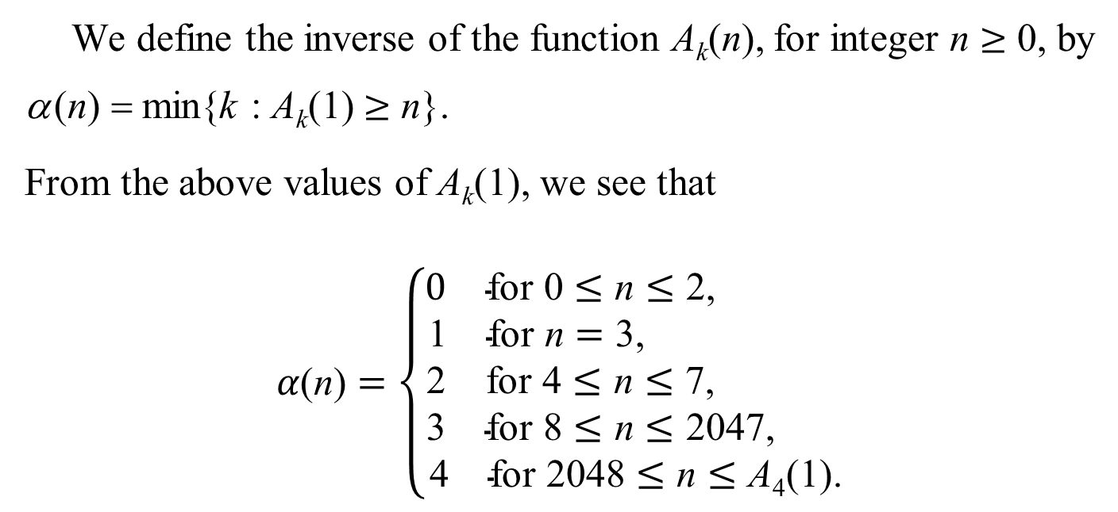
We define the inverse of the function A_{k}(n), for integer n ≥ 0, by
α(n) = min{k : A_{k}(1) ≥ n}.
From the above values of A_{k}(1), we see that
$$α\text{(}\text{n}\text{)}=\left\{\begin{matrix}\begin{matrix}0 & \text{for}\text{ 0}≤\text{n}≤\text{2,}\end{matrix} \\ \begin{matrix}\begin{matrix}\text{1} & \text{for} \text{n}=\text{3, }\end{matrix} \\ \begin{matrix}\text{2} & \text{for}\text{ 4}≤\text{n}≤\text{7,}\end{matrix} \\ \begin{matrix}\text{3} & \text{for}\text{ 8}≤\text{n}≤\text{2}\text{047, }\end{matrix}\end{matrix} \\ \begin{matrix}\text{4} & \text{for}\text{ 2048}≤\text{n}≤\text{A}\text{4}\text{(1).}\end{matrix}\end{matrix}\right.$$

